Slide 1



Air Quality Prediction after 24 Hours

Slide 2

Learning Objectives
Understand the importance of monitoring air pollution.
Learn how to preprocess air quality datasets.
Implement Machine Learning models for AQI prediction.
Evaluate accuracy and visualize results.
GOAL

Slide 3
Tools and Technology used
IBM Cloud
Watsonx.ai Studio
IBM Cloud Object Storage
IBM AutoAI
IBM Machine Learning Model
Jupyter Notebook

Slide 4
Methodology
Data Collection (Air Quality dataset)
Data Cleaning (handling missing values)
Feature Engineering (lag variables, pollutant trends)
Model Training (ML algorithms for prediction)
Model Evaluation (MAE, RMSE, R²)
Visualization of predicted AQI vs actual AQI

Slide 5
Problem Statement:
Air pollution has become a critical environmental issue, causing health hazards and climate effects. There is a need for a system to predict AQI in advance so that preventive actions can be taken.

Slide 6
Solution:
We propose a Machine Learning based AQI prediction model that:
Predicts AQI values 24 hours ahead.
Helps government, organizations, and citizens plan precautionary measures.
Provides a decision-support tool for air quality management.

Slide 7
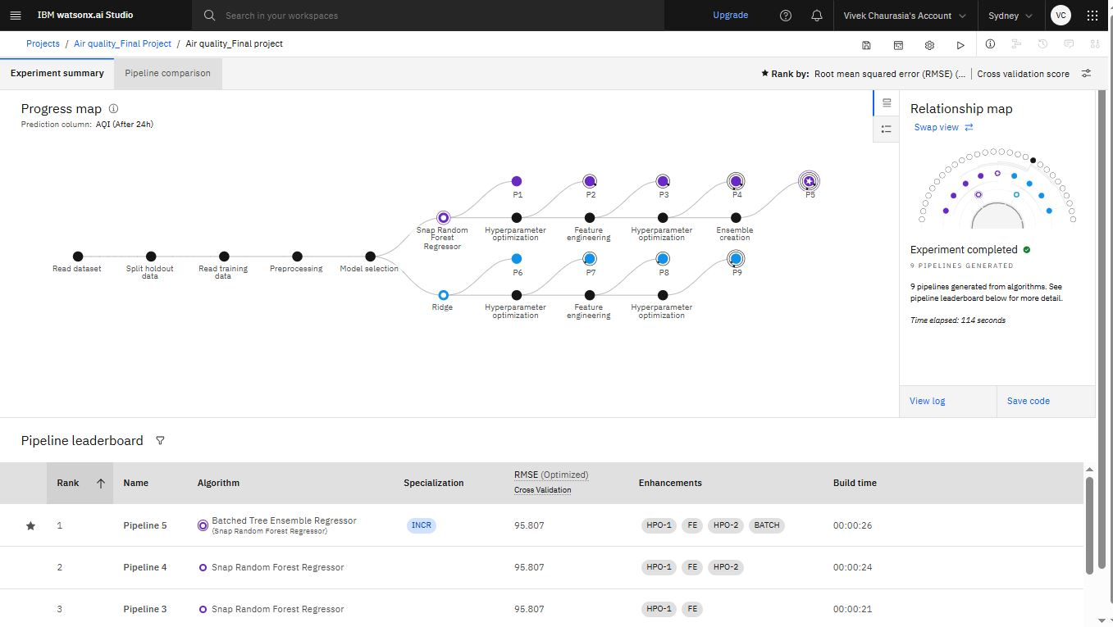
Screenshot of Output:
Result 1:

Slide 8
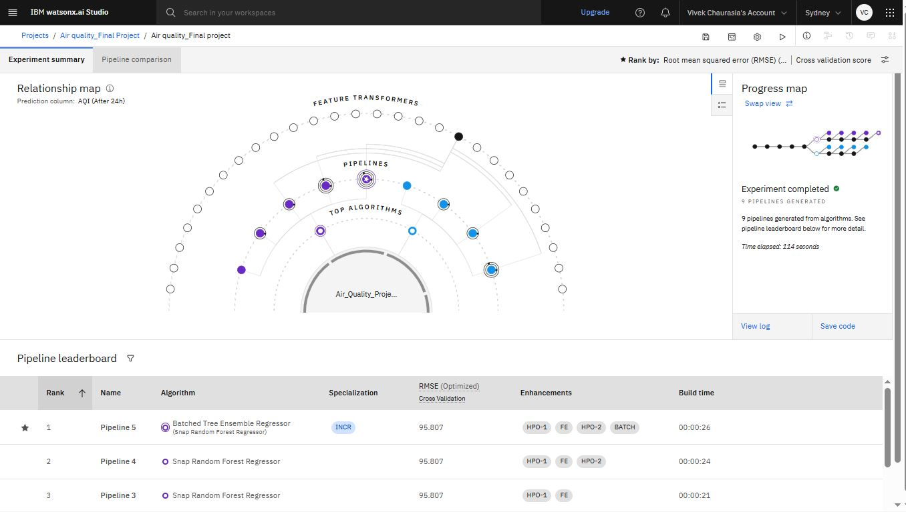
Screenshot of Output:
Result 2:

Slide 9
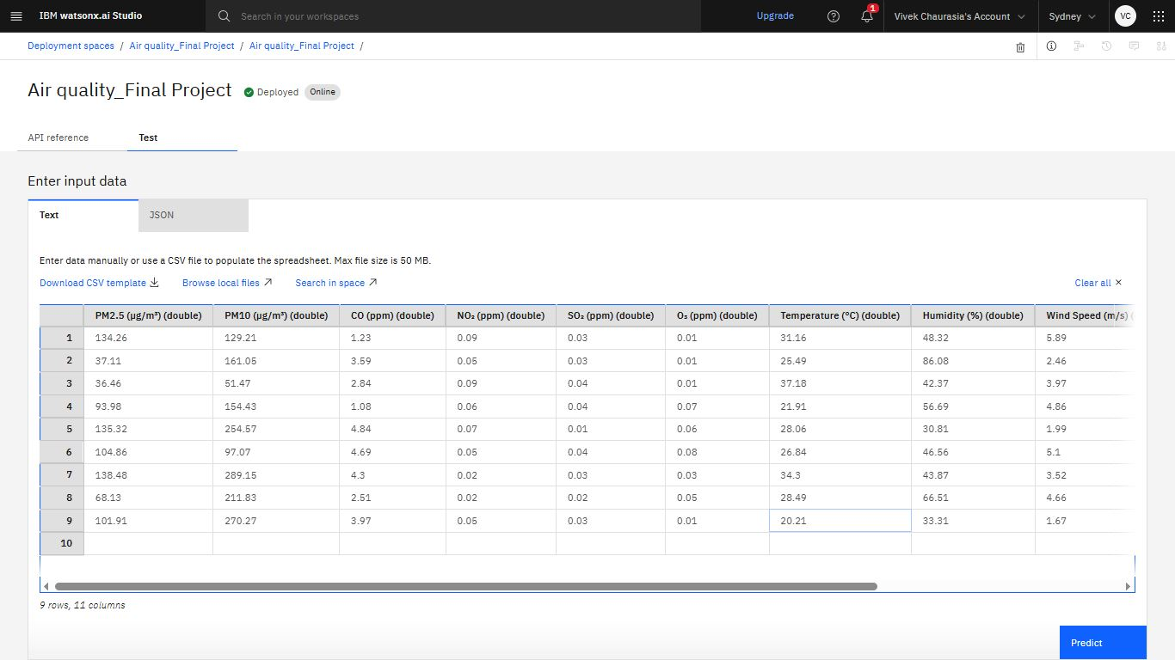
Screenshot of Output:
Result 3:

Slide 10
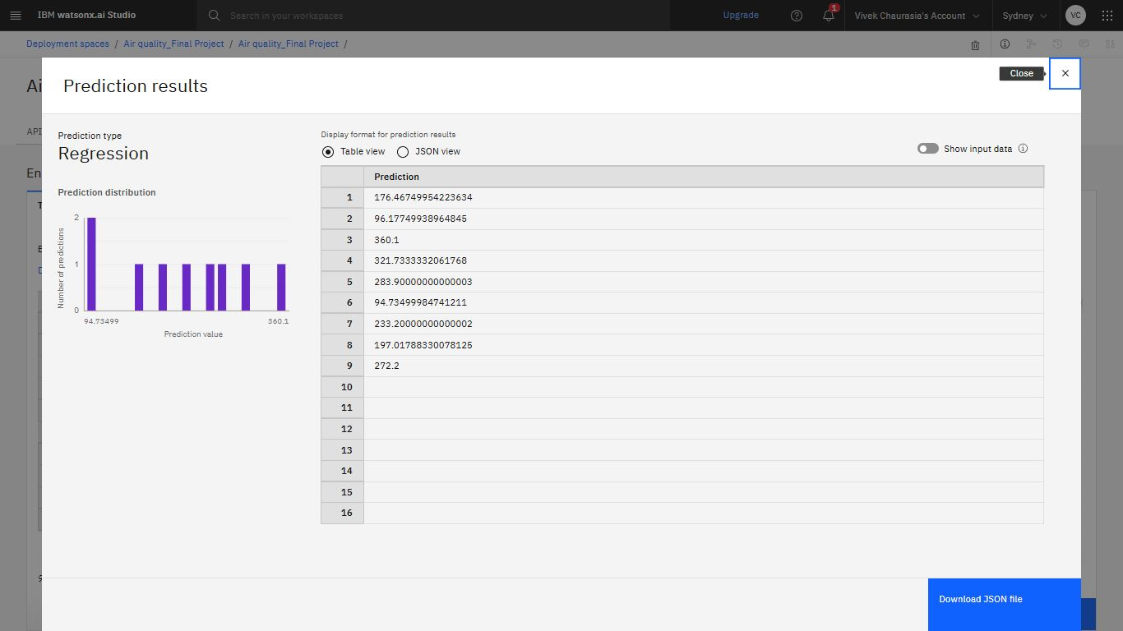
Screenshot of Output:
Result 4:

Slide 11
Conclusion:
Successfully built a predictive model for AQI forecasting.
Prediction helps in early warnings for pollution control.
Can be extended with real-time data for better accuracy.
Future scope: Integration with IoT sensors and Cloud platforms.

